Slide 1


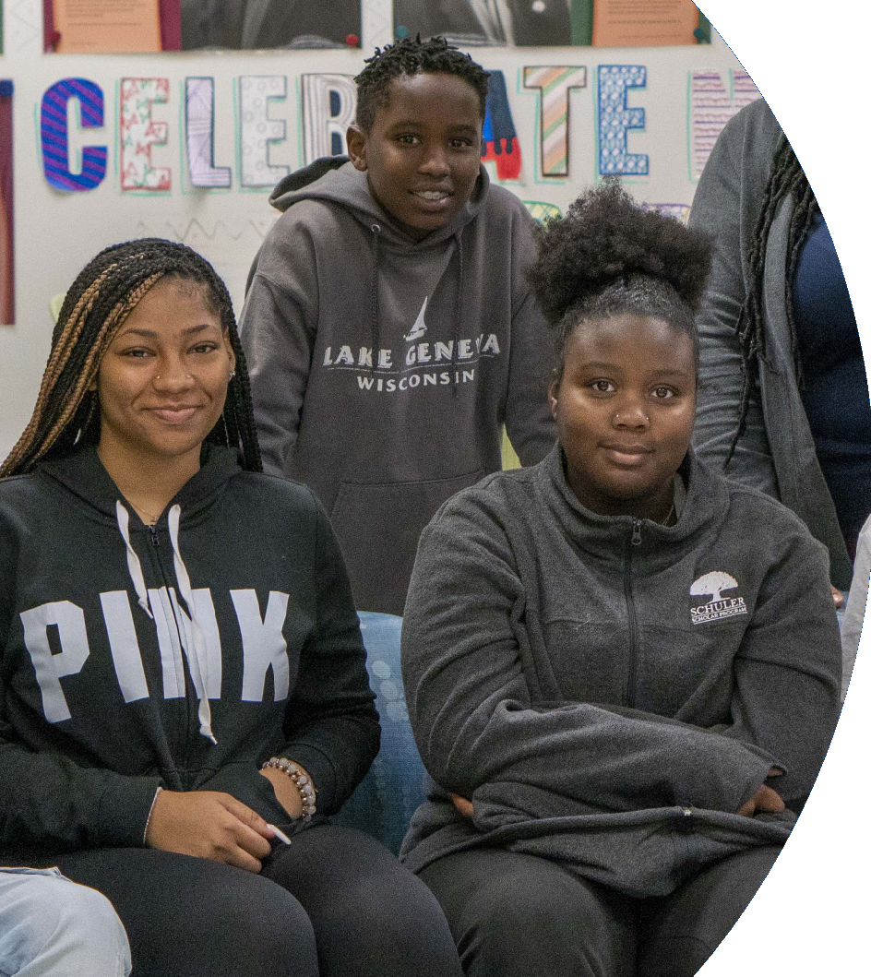
The Intersectionality of the Departments of
Black & Latino Male Achievement and Gender & Identity Inclusion
October 19, 2022
Dr. Keith P. Posley
Superintendent
Presenters:
Nate Deans Jr., Director, Black and Latino Male Achievement
Ebony Lewis, Director, Gender and Identity Inclusion

Slide 2
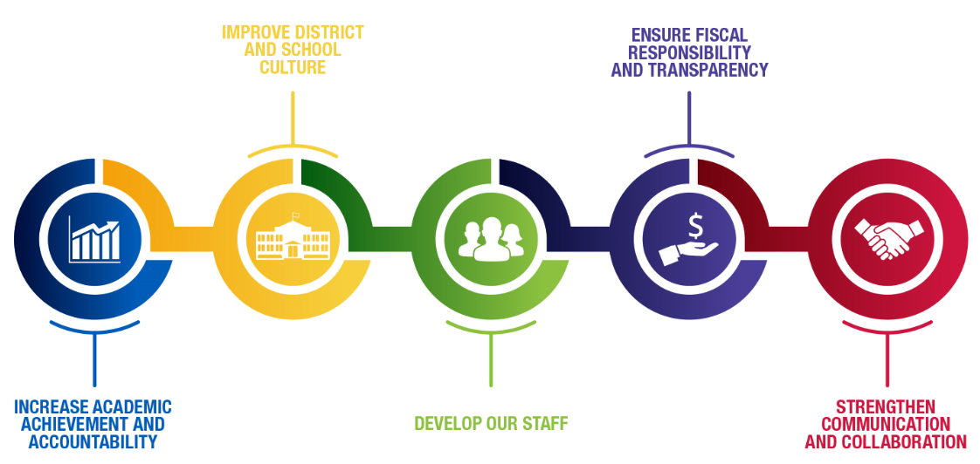
Five Priorities for Success

Slide 3
Milwaukee Public Schools
Diversity is our strength!
68,435 students
156 schools
13.8% English language learners
19.6% special education
75.2% economically disadvantaged*
*Alternate income forms continue to be received and evaluated. Data as of 10-3-2022.
Notes:
As of February 17, 2020

Slide 4
Overview
In 2017, Milwaukee Public Schools created the Department of Black and Latino Male Achievement, and in 2021, the Department of Gender and Identity Inclusion was born. Together these departments are helping to support the overall success, mental well-being, and academic achievement of students of color and LGBTQ+ students within the district.
This presentation will highlight how these departments work individually and collectively to provide resources, support, professional learning opportunities, and culturally relevant experiences that enhance school culture and climate for all students, staff, and families. As we focus on improving achievement and closing gaps in urban schools, we have learned that these very specific, equity-focused departments are pillars of the future success of urban education.
.
© 2022 Milwaukee Public Schools
4

Slide 5
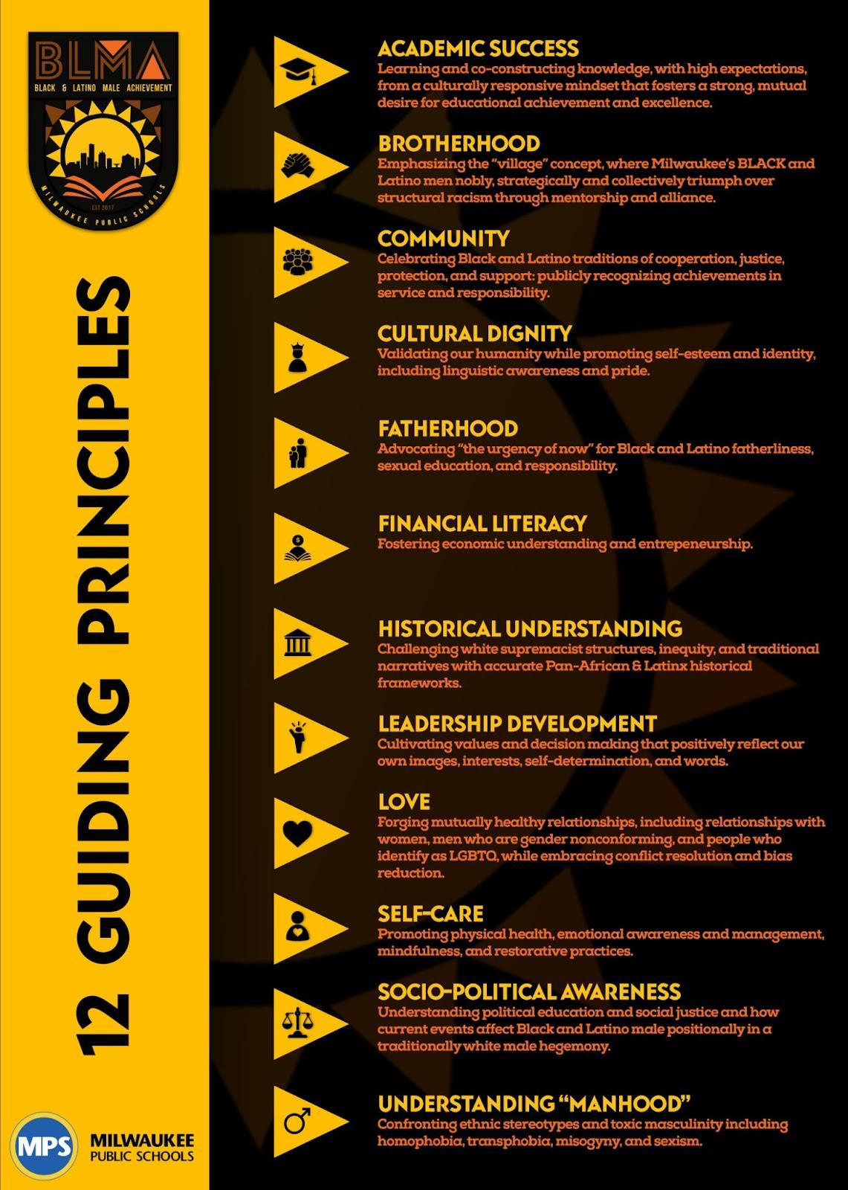
BLMA Mission and Vision
The mission of the Department of Black and Latino Male Achievement is to collaboratively work to improve the outcomes of Black and Latino male students within Milwaukee Public Schools by challenging systems, structures, and spaces of oppression and seek to create conditions that promote greater success.
The BLMA vision is that Black and Latino boys and young men will possess an affirmed sense of identity, dignity, and self-confidence and will have the necessary tools to triumphantly navigate K–12, college, career, and life.
.
© 2022 Milwaukee Public Schools
5

Slide 6

Gender and Identity Inclusion Mission and Vision
Mission: The MPS Department of Gender and Identity Inclusion works to ensure that all girls of color and LGBTQ+ students in Milwaukee Public Schools are provided with safe, equitable, and inclusive environments and resources that support their holistic development and success.
Vision: Girls of color and LGBTQ+ students in Milwaukee Public Schools feel affirmed and are empowered to grow, learn, thrive, succeed, and be themselves.
.
© 2022 Milwaukee Public Schools
6

Slide 7
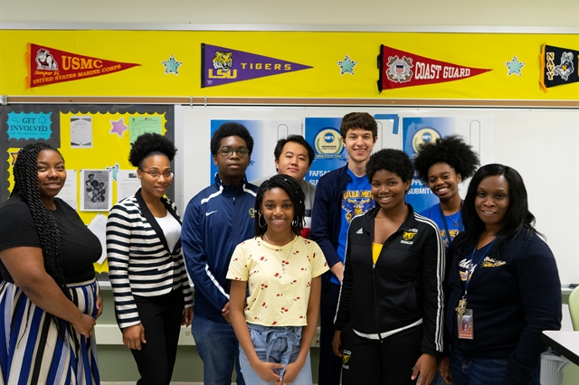
Equity, Access, and Inclusion
Equity, Access, and Inclusion is committed to ensuring that all students receive equitable resources, supports, and opportunities regardless of race, ethnicity, socioeconomic background, mobility, gender identity, sexual orientation, disability, language, or initial proficiencies.
Using data-driven continuous improvement in the implementation of equitable and culturally and linguistically responsive practices district-wide, a focus on 21st-century skills is used to meet the diverse needs of all students and staff and to ensure that all students will grow, thrive, and contribute to a global society.
Restorative Practices | Positive Behavioral Interventions and Supports (PBIS)
Restorative practices is a framework that refers to all the things that we do to build, maintain, and repair relationships. When being restorative, we honor cultures and identities, ensure that all voices are heard, and foster connections. This framework naturally creates cultures where everyone is accountable and supported in striving to be their best selves socially and academically. Restorative practices is not new to Milwaukee Public Schools. In 2004, Milwaukee County Assistant District Attorney, the late David Lerman, introduced restorative justice to school social workers in Milwaukee Public Schools. Since then, restorative practices within MPS has evolved and grown, leading to a variety of opportunities and collaborative partnerships. | In 1997, an amendment to the Individuals with Disabilities Education Act included the language “positive behavioral interventions and supports,” which described methods used to identify and support desired behaviors in the school setting. The goal of PBIS is to create a positive school climate in which students learn and grow. PBIS is a decision-making framework that guides selection, integration, and implementation of the best of the research-based academic and behavioral practices and interventions for improving student academic and behavior outcomes for all students.
.
© 2022 Milwaukee Public Schools
7

Slide 8






Levels of Support
Student Listening Sessions
Professional Learning Opportunities
Mentorship
Specialized Programming/Events
Community Partnerships/Resources
Advocacy and Social Activism
.
© 2022 Milwaukee Public Schools
8

Slide 9
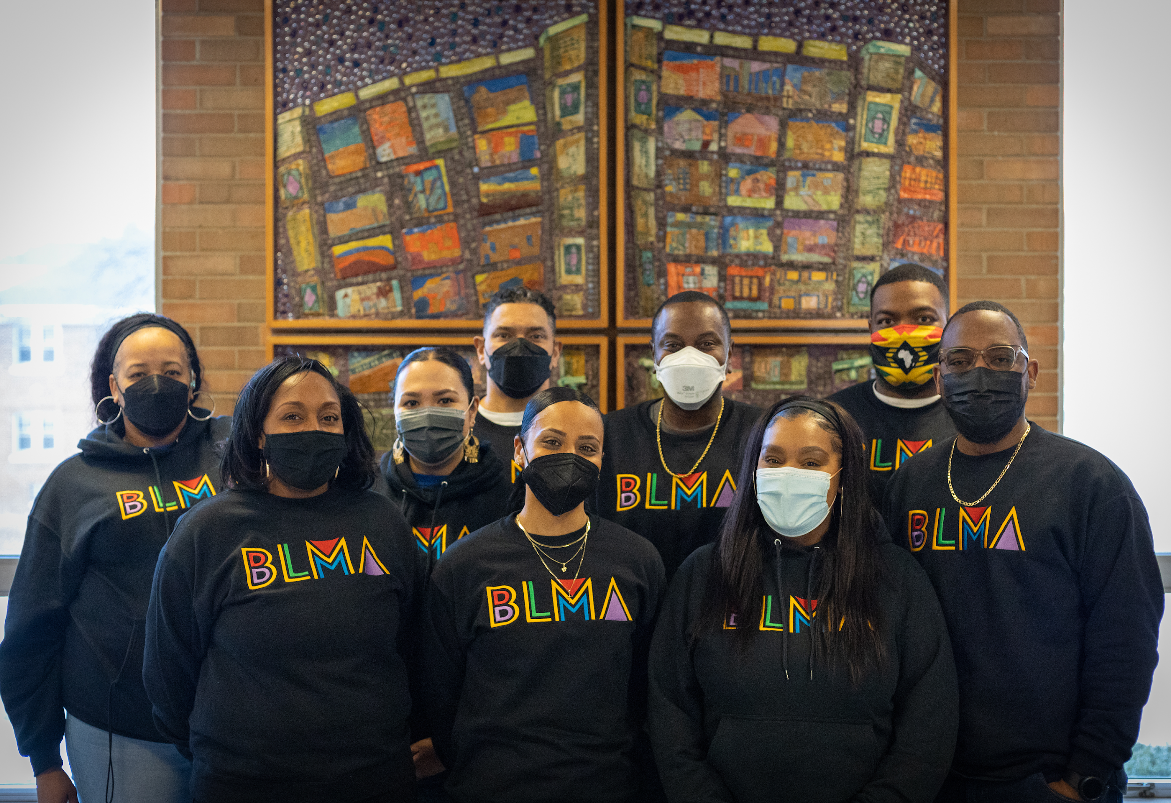
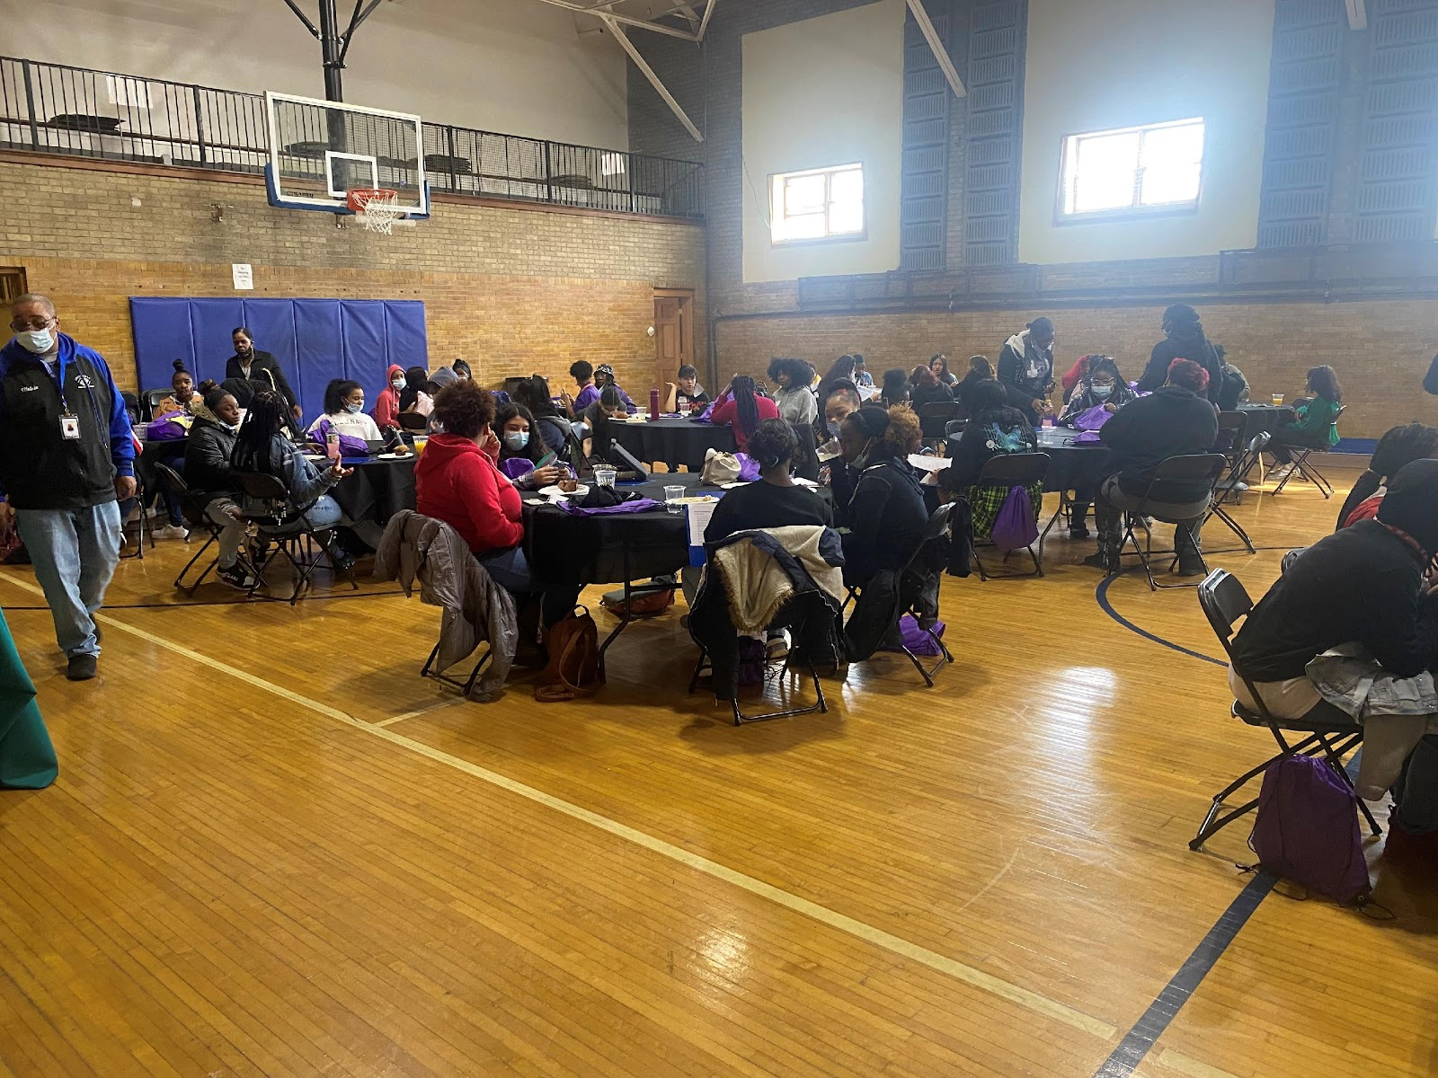


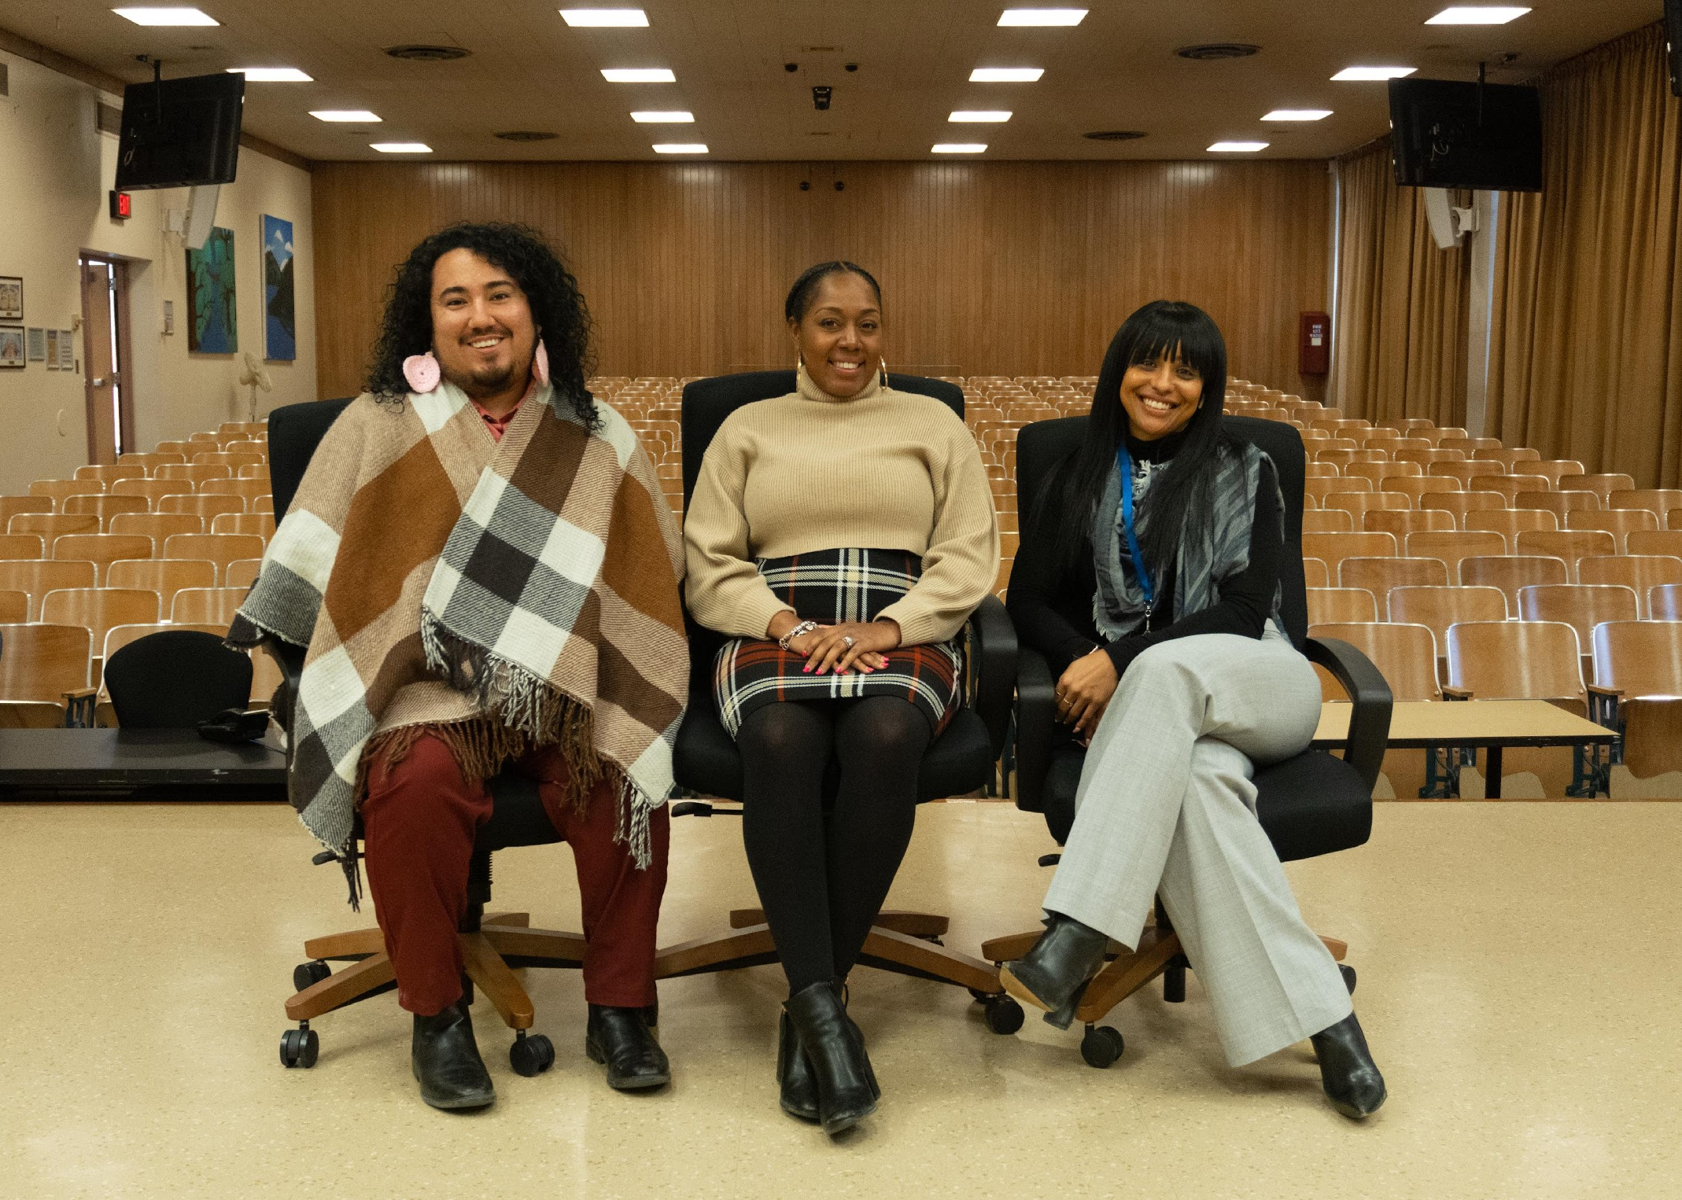



Top Benefits of Creating Equity-Based Departments
Providing consistent and equitable support for students and families of marginalized groups, coupled with enhanced professional learning opportunities and resources, has many benefits for the overall achievement of schools and their district. Studies have found that when schools and organizations have departments that focus on inclusivity, the overall culture and climate of the entire school is enhanced.
Increase in academic achievement
Stronger student attendance/engagement
Increase in mental wellness
Innovative approach to discipline discrepancies
Increase in culturally competent teachers/administrators
.
© 2022 Milwaukee Public Schools
9

Slide 10
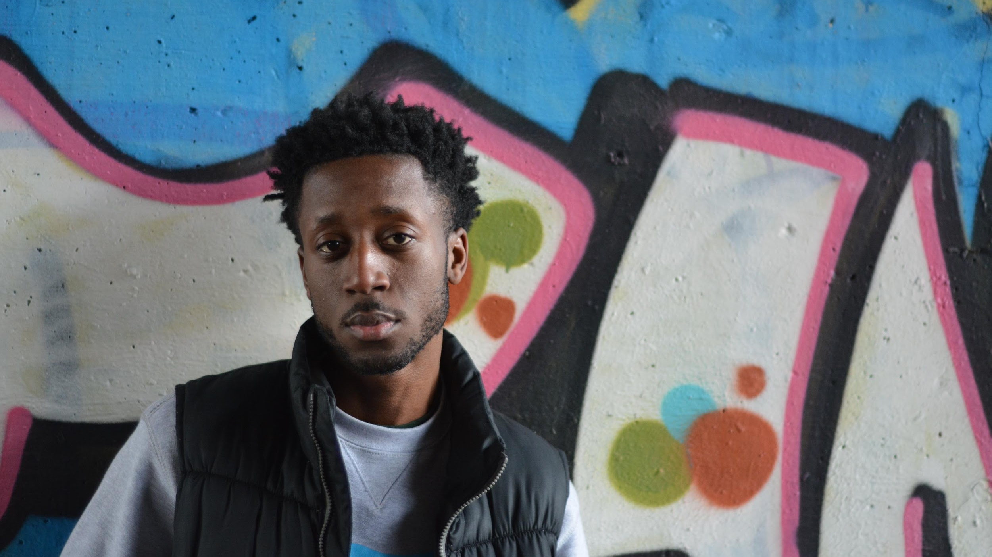
Black and Latino Male Achievement Updates
Provided BLMA Buddies Program to grades four and five in 8 schools
120 Manhood Development Academy students across 2 high schools
Hosted first annual Mental Health Summit event to bring awareness to Black and Latino students
Ongoing partnership with Mentor Greater Milwaukee to provide services to students; 110 students across 10 schools met with and were paired with community mentors
#SeeMeBecause is Art Start’s campaign to start a dialogue about what it means to be seen; in 2018 and 2019, the campaign highlighted Black and Latino young men within MPS and how they ask to be seen
.
© 2022 Milwaukee Public Schools
10

Slide 11

Girls of Color Updates
Conducted listening sessions at 12 sites and piloted workshops at sites that supported female-identifying students in grades four to twelve
Hosted first annual Denim Day event to bring awareness of sexual assault and rape; 200 female-identifying students received our awareness training centered on consent, understanding sexual assault, and tips, tools, and resources on how to report and begin healing
Built partnerships with Pearls for Teen Girls and Girls On The Run to offer ongoing consistent programming for girls at 15 sites in the 2022–23 school year
The Miseducation of Girls of Color training/workshop
.
© 2022 Milwaukee Public Schools
11

Slide 12
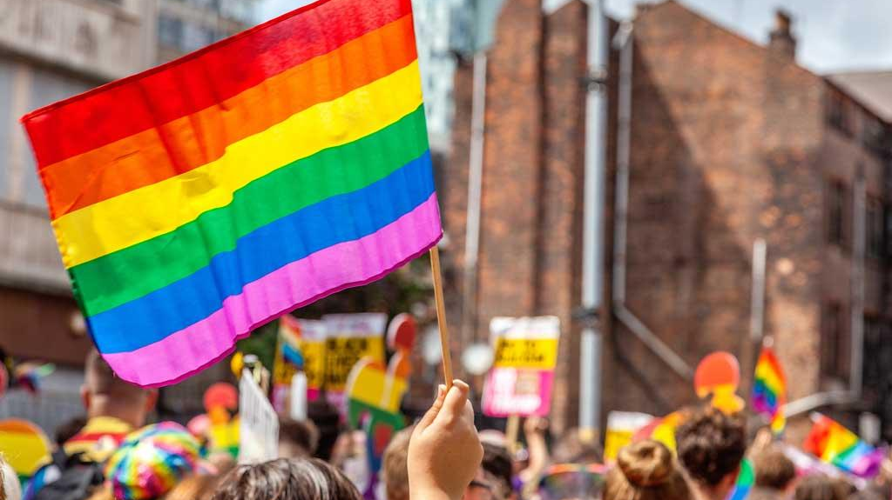
LGBTQ+ Support/Inclusivity Updates
Assisted with the creation and sustainability of Gender Sexuality Alliances (GSA) throughout the district;
20 sites have an active GSA club at their school; 80 advisors have expressed interest
in starting a GSA for 2022–23
The Alliance School was the first school in the nation to start with a mission of reducing bullying. The school opened in 2005 with a goal of providing safe and accepting environment for all students.
Created/enhanced Milwaukee Public Schools Gender Inclusion Guidance to support our transgender,
non-binary, and gender nonconforming students
Partnered with the Human Rights Campaign on their Welcoming Schools Inclusivity training module
.
© 2022 Milwaukee Public Schools
12

Slide 13
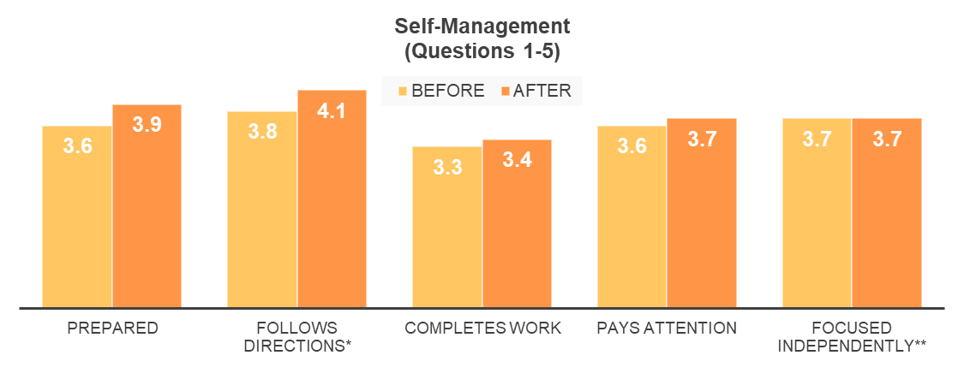
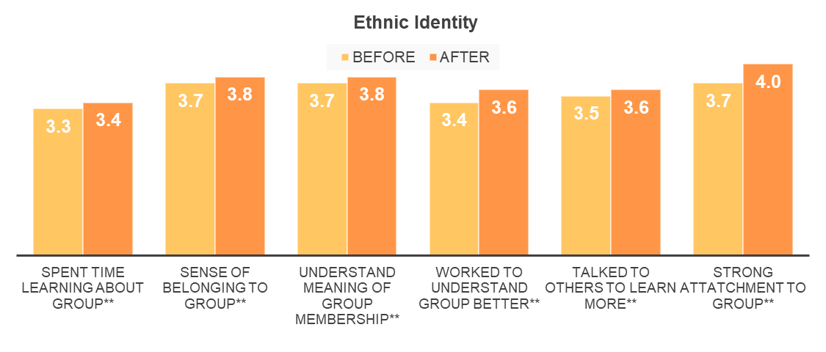
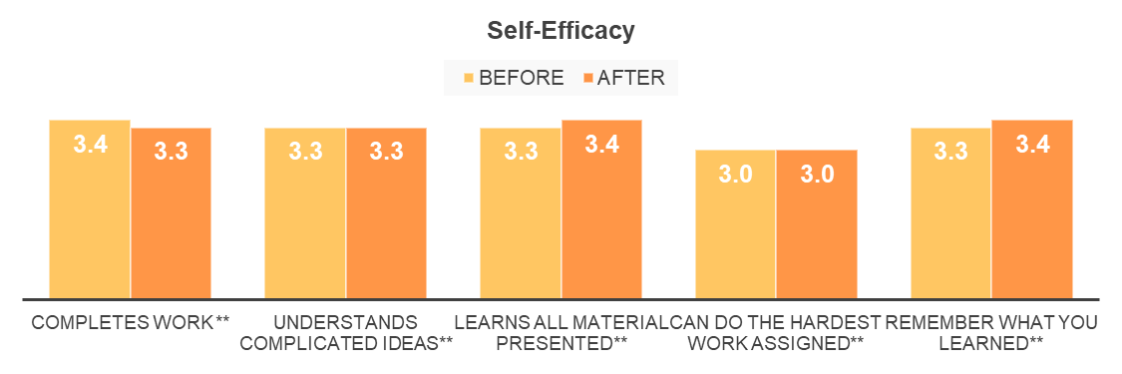
Case Study: Manhood Development Course
2020–21 Survey Data
Manhood Development Course
The BLMA Manhood Development Academy is an elective for-credit course currently offered in two MPS schools. The content of the course promotes positive racial/ethnic identity by using culturally relevant materials and text as well as incorporating the BLMA Twelve Guiding Principles for our young men to live by.

Slide 14

Intersecting the Work
Building to provide mentors for all students
Intersecting special events
Enhancing culturally relevant curriculum
Highlighting student voice
LGBTQ+ support/inclusivity for all students
.
© 2022 Milwaukee Public Schools
14

Slide 15

Sustaining the Work
Equity-based departments are critical to the overall success of our students and our schools. This model is helping to streamline practices that will allow administration and educators to set a tone in their schools and classrooms that will allow students to feel seen, safe, and heard. We know that these very intentional supports will shift culture and climate across districts everywhere.
.
© 2022 Milwaukee Public Schools
15

Slide 16
Let's Stay in Touch
Nate Deans – Director, Department of Black and Latino Male Achievement
deansjnd@milwaukee.k12.wi.us
Ebony Lewis – Director, Department of Gender and Identity Inclusion
lewise2@milwaukee.k12.wi.us
.
© 2022 Milwaukee Public Schools
16

Slide 17
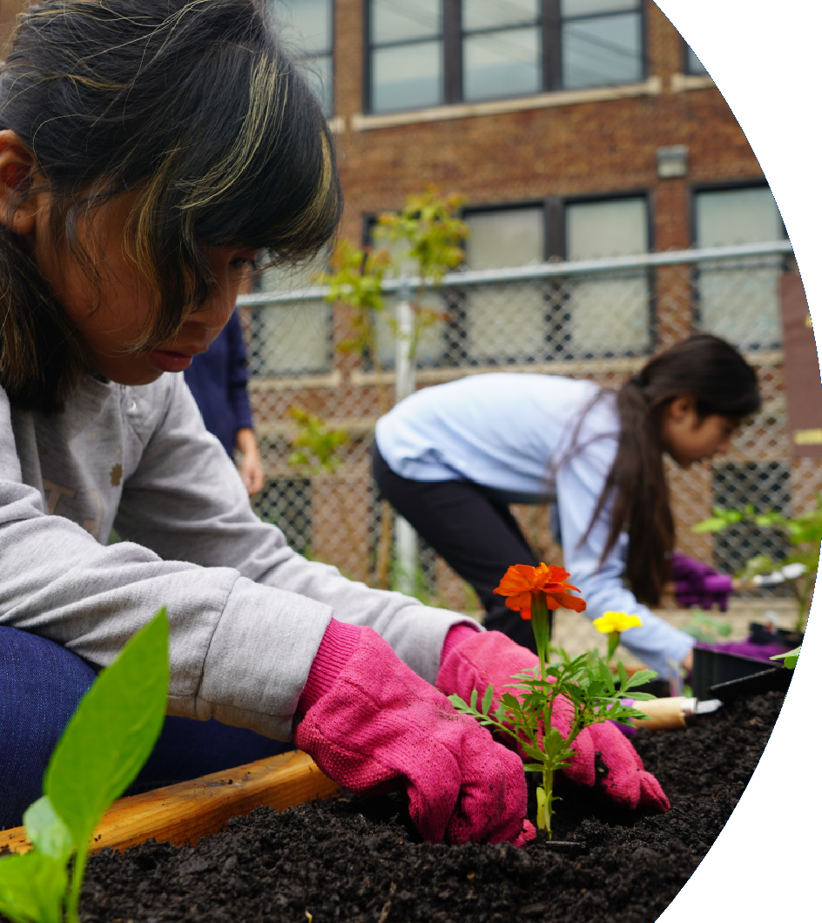
Thank
You!

